Slide 1
Helicene project (so far…)
Joseph Harries

Slide 2
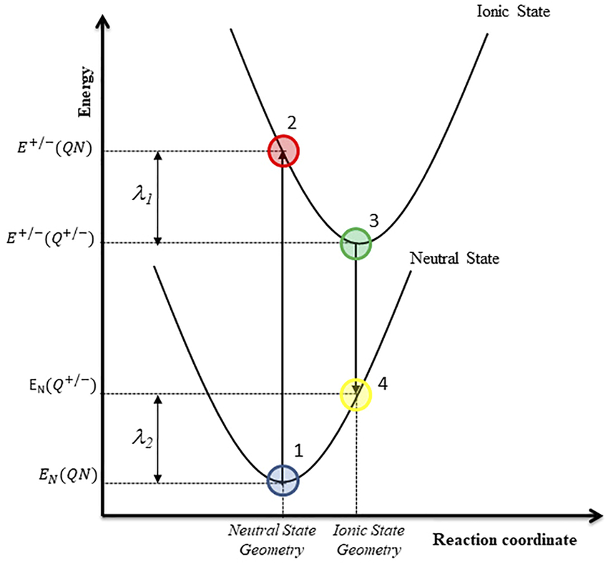
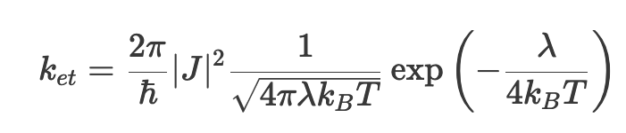
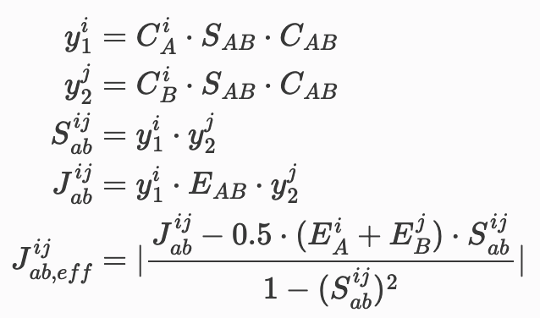
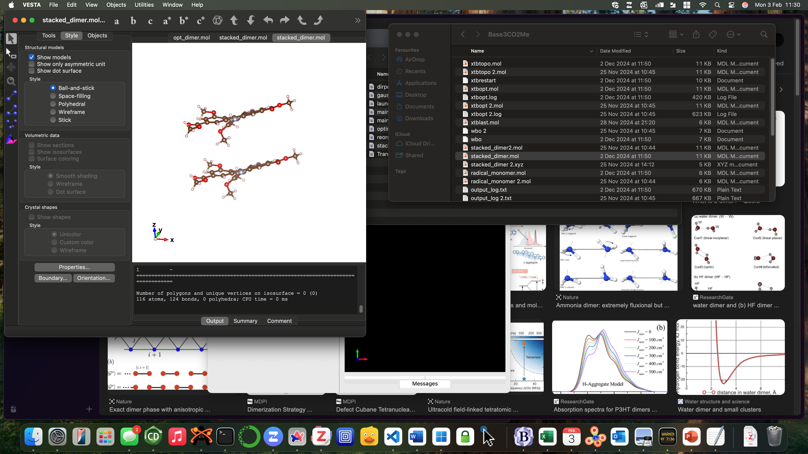
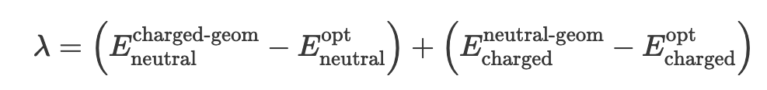
Methods
Reorganisation energy (four point method):
Marcus theory (charge hopping rate):
Transfer Integral (DIPRO via xtb 6.7.1):
C: orbital coefficients
S: AO overlap matrix
E: orbital energies
i, j: MOs considered for charge transfer
López-Estrada, O., Laguna, H. G., Barrueta-Flores, C. & Amador-Bedolla, C. Reassessment of the Four-Point Approach to the Electron-Transfer Marcus–Hush Theory. ACS Omega 3, 2130–2140 (2018).
J_{ab}
Kohn, J. T., Gildemeister, N., Grimme, S., Fazzi, D. & Hansen, A. Efficient calculation of electronic coupling integrals with the dimer projection method via a density matrix tight-binding potential. The Journal of Chemical Physics 159, 144106 (2023).

Slide 3
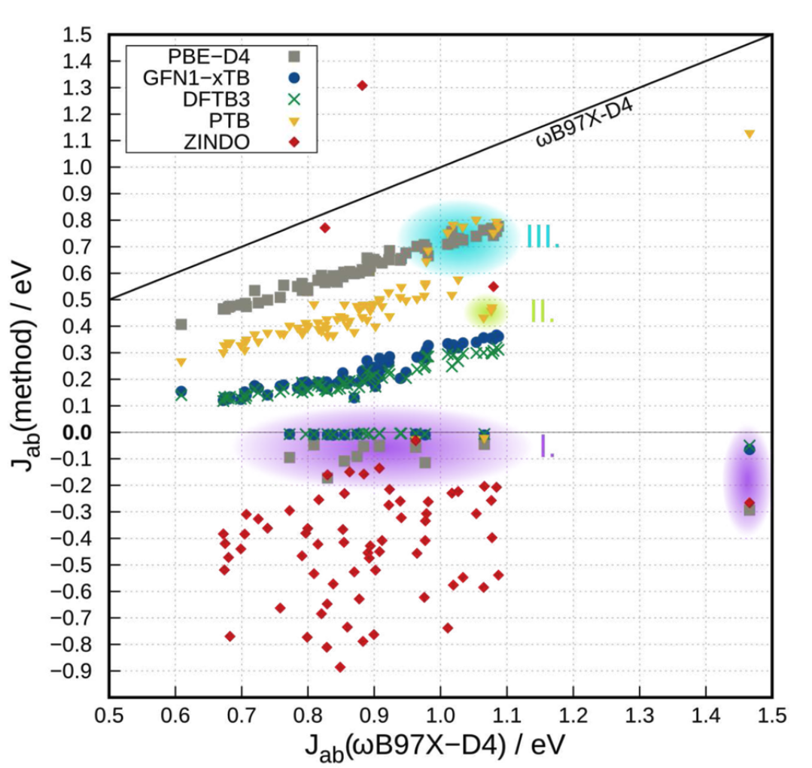
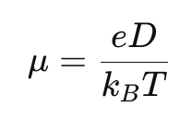
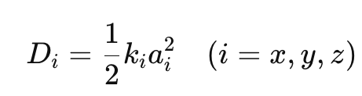
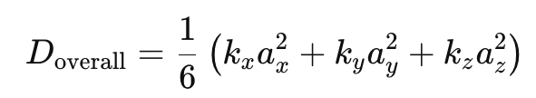

Methods (cont.)
Note for DIPRO calculations, scaling factor required:
How to get k_{et} $→μ?$
For hopping mechanism:
1.921
k: rate
a: distance between hopping sites
So for 3 dimensions:
difficult to quantify
Kohn, J. T., Gildemeister, N., Grimme, S., Fazzi, D. & Hansen, A. Efficient calculation of electronic coupling integrals with the dimer projection method via a density matrix tight-binding potential. The Journal of Chemical Physics 159, 144106 (2023).

Slide 4
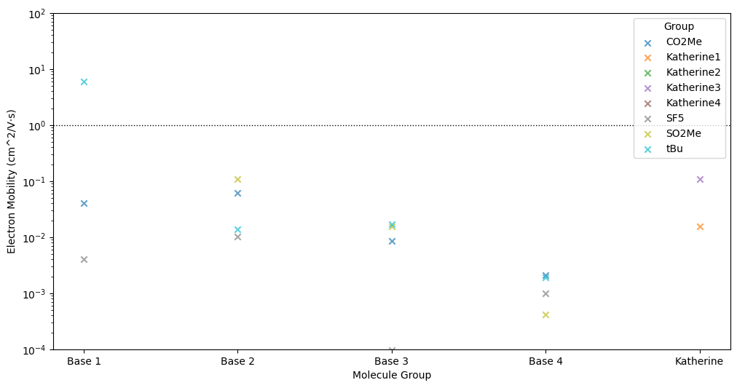
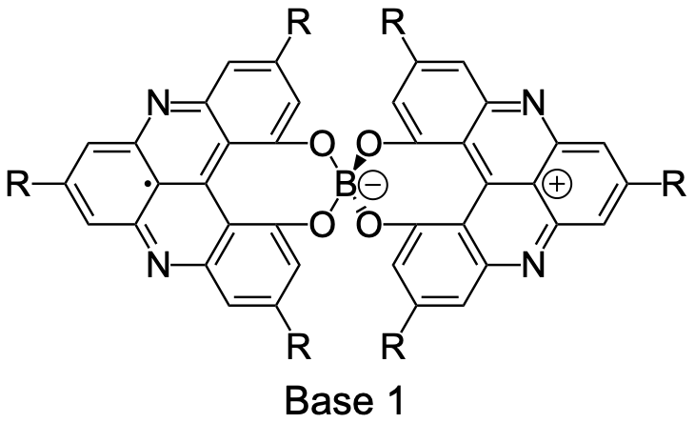
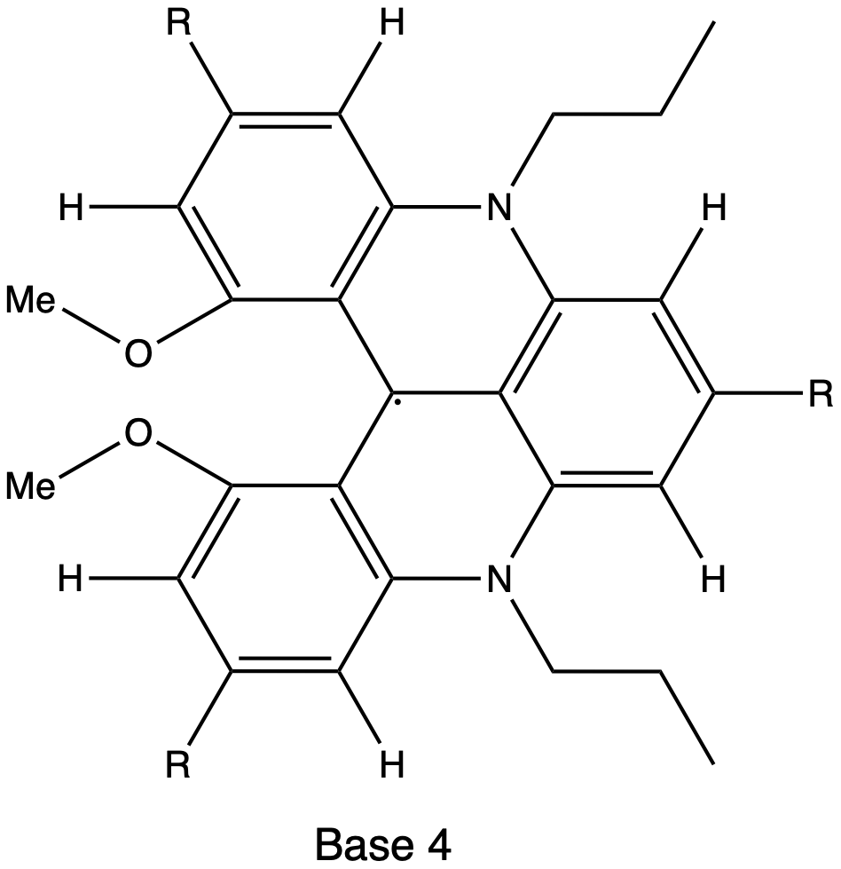
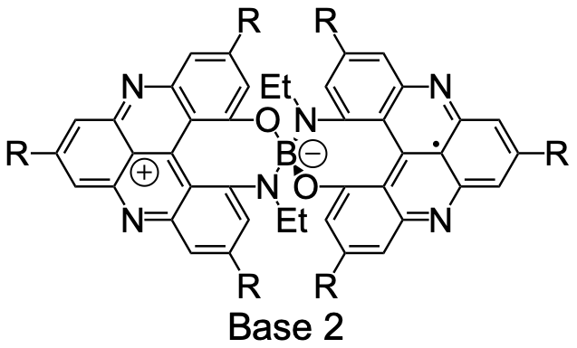
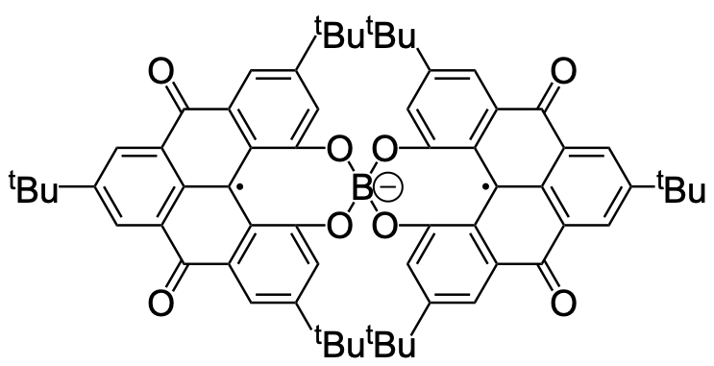
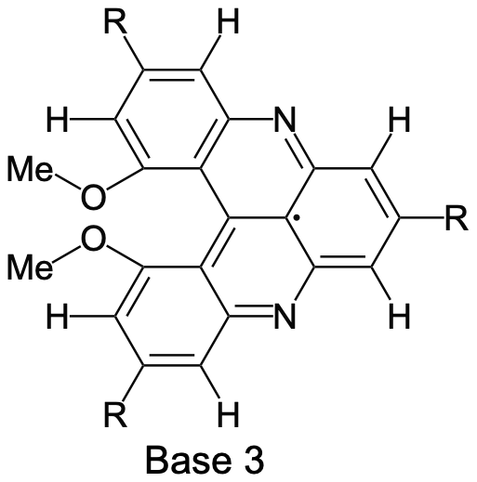
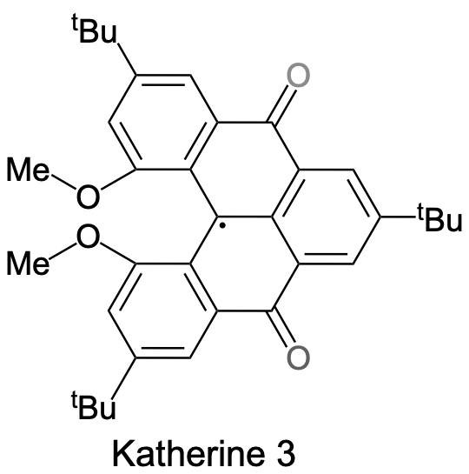

Results
(Closed Ring):
e- 𝜇 (cm^2/V·s) | h+ 𝜇 (cm^2/V·s)
2.16E+01 | 2.22E-02
1.85E+00 | 1.79E-03
Neutral:
Radical:
e⁻ $μ$ for all molecules:
Katherine 1

Slide 5
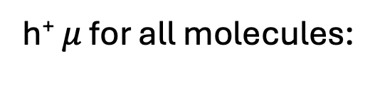
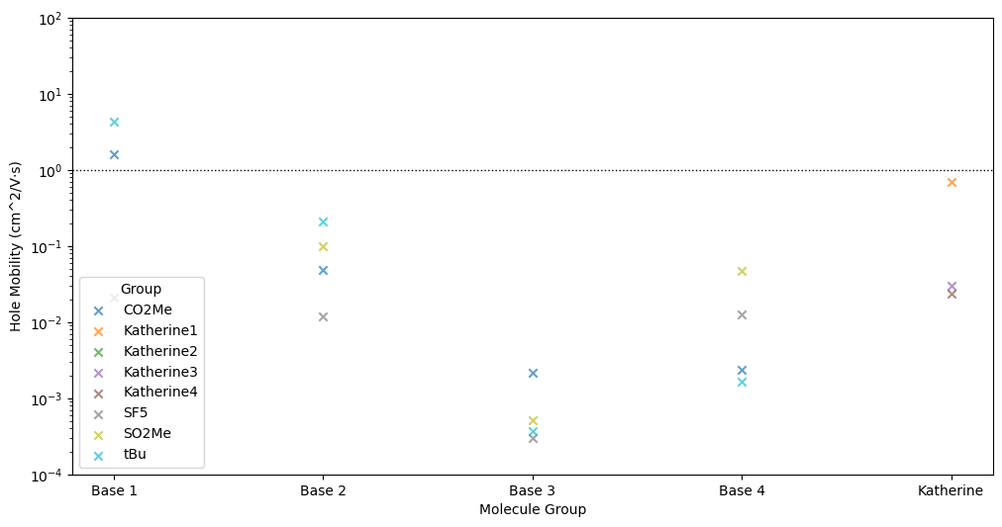
Results (cont.)
(Closed Ring):
e- 𝜇 (cm^2/V·s) | h+ 𝜇 (cm^2/V·s)
2.16E+01 | 2.22E-02
1.85E+00 | 1.79E-03
Neutral:
Radical:
h⁺ $μ$ for all molecules:
Katherine 1

Slide 6
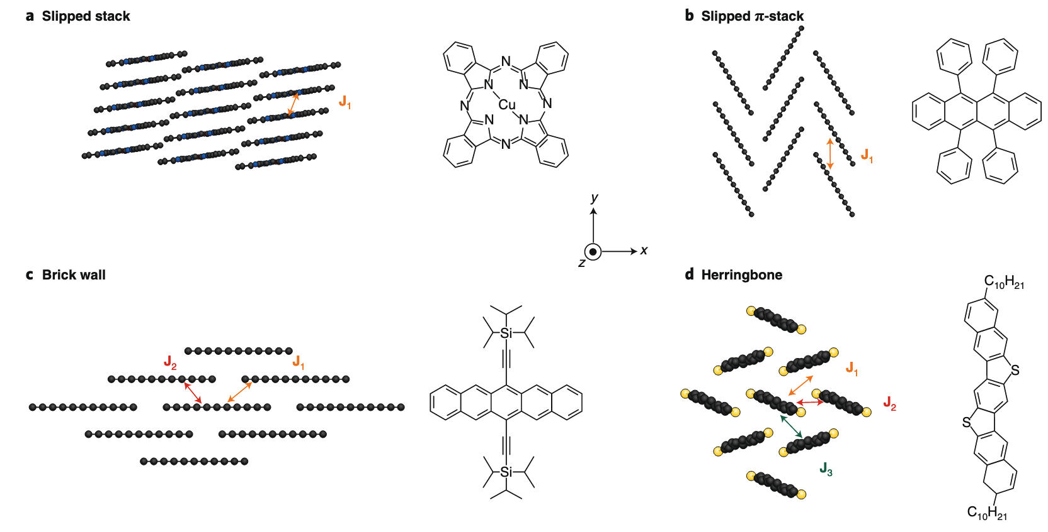
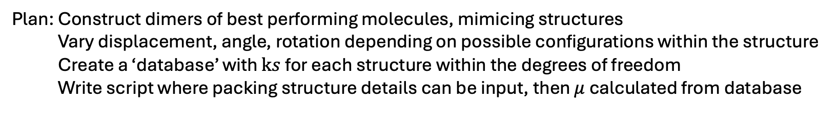
Current work / future ideas
(84 days left until submission
50 days to easter break)
Bulk packing/polymorphs:
Main structures/transport pathways observed in semiconductors:
Gather more Gaussian data to validate
DIPRO scaling:
Fratini, S., Nikolka, M., Salleo, A., Schweicher, G. & Sirringhaus, H. Charge transport in high-mobility conjugated polymers and molecular semiconductors. Nat. Mater. 19, 491–502 (2020).
(Validated against packing reported for [4] and [5]helicene derivatives in CSD)
Plan: Construct dimers of best performing molecules, mimicing structures
Vary displacement, angle, rotation depending on possible configurations within the structure
Create a ‘database’ with $ks$ for each structure within the degrees of freedom
Write script where packing structure details can be input, then $μ$ calculated from database

